Slide 1
Nba Playoff qualification using machine learning
Roni Kaakaty
DSC630

Slide 2
Motivation
Develop a machine learning model that can provide business owners with a tool that they can use to gauge how close their team is to qualifying for the playoffs.
Identify which attributes contribute the most to winning.
Assess their team’s weaknesses and how their statistical categories compare with previous playoff teams.
Tool can be used for player acquisition to target individuals that will boost team’s weaknesses.
Qualifying for the playoffs is a lucrative financial proposition for team owners.

Slide 3
Data Methods
Compiled data sets from 1979-2021 using Basketball-Reference.
Started with 1979 because that’s when the 3pt. line was introduced.
Excluded the following seasons from the training set:
1995 NBA Season- Shortened season due to NBA lockout.
2011 NBA Season- Shortened season due to NBA lockout.
2020 NBA Season- Shortened season due to pandemic.
Removed team names due to relocation of teams from one conference to the other over the years.

Slide 4
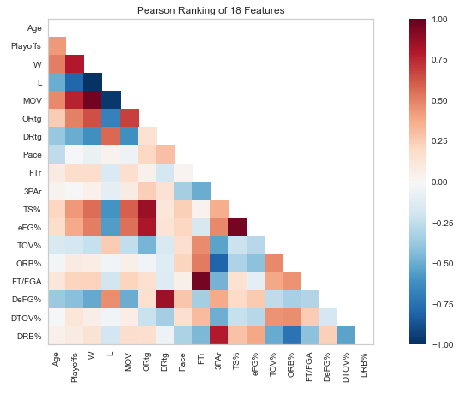
Model Selection
Selected a linear regression model due to evidence of variables that are positively correlated with Playoff Qualification variable.
Will construct two separate models for Eastern Conference and Western Conference qualification because each conference have their own playoff qualification standards.
Eastern Conference has on average required less wins to qualify for the playoffs.

Slide 5
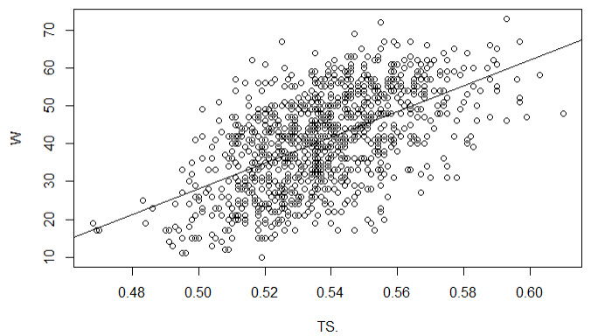
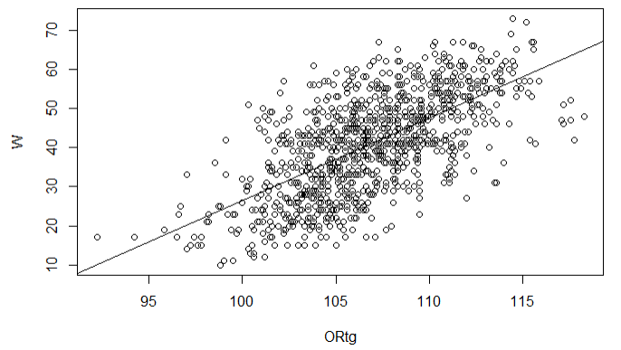
Model Selection, cont.
Wins vs. True Shooting Percentage
Wins vs. Offensive Rating

Slide 6
Model Metrics
Model has proven to be successful. Eastern Conference model training set has a coefficient of determination score of 57.49%, which is close to the test set score of 61.02%. The Western Conference model has a training set score of 67.64% and a test set score of 60.21%.
The coefficient of determination is a statistical measurement that examines how differences in one variable can be explained by the difference in a second variable, when predicting the outcome of a given event.
Both models also have a low mean squared error (MSE), which tells you how close a regression line is to a set of points.

Slide 7
Challenges
Rule changes have changed the significance of certain statistics. For entertainment purposes, the NBA has instituted various rules such as disallowing hand-checking on the perimeter and defensive 3-seconds as ways to limit the ability of a defender to guard.
New era of basketball contributes to skewing offensive categories as there is a greater emphasis on the 3pt. Shot and devaluing the 2pt. Field goal.
Teams moving from one conference to another also presented a challenge and was handled by changing the scope of the project to not include team names, instead aligning them by conference affiliation at the time.

Slide 8
Next Steps
Goal is to find ways to improve model accuracy, precision, efficiency.
Will attempt different models to see if that can lead to improved model performance.
Compare metrics between conferences to see if there are any significant outliers between the two.

Slide 9
References
Accounting for basketball: The money behind the madness. (n.d.). Retrieved from https://www.kenan-flagler.unc.edu/news/accounting-for-basketball-the-money-behind-the-madness/#:~:text=In the NBA, there is,playoff dollars however they wish.
Burd, B. (2020, October 01). How Much Do NBA Players Make in the Playoffs? Retrieved from https://thesportseconomist.com/how-much-do-nba-players-make-in-the-playoffs/
How NBA Analytics is Changing Basketball: Merrimack College. (2020, June 25). Retrieved from https://onlinedsa.merrimack.edu/nba-analytics-changing-basketball/
1979-80 NBA Season Summary. (n.d.). Retrieved July 05, 2021, from https://www.basketball-reference.com/leagues/NBA_1980.html
Reynolds, T. (2020, October 10). 10 things to know as 2020 NBA playoffs begin. Retrieved from https://www.nba.com/news/10-things-know-playoffs-begin

